Slide 1

CRACKING HASHES USING HASHCAT

Slide 2
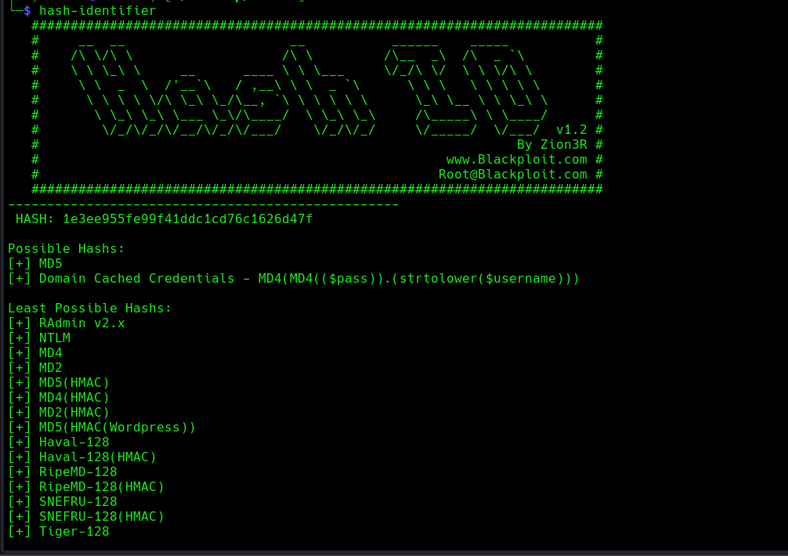

STEP 1
Same as before……
STEP 2

Slide 3
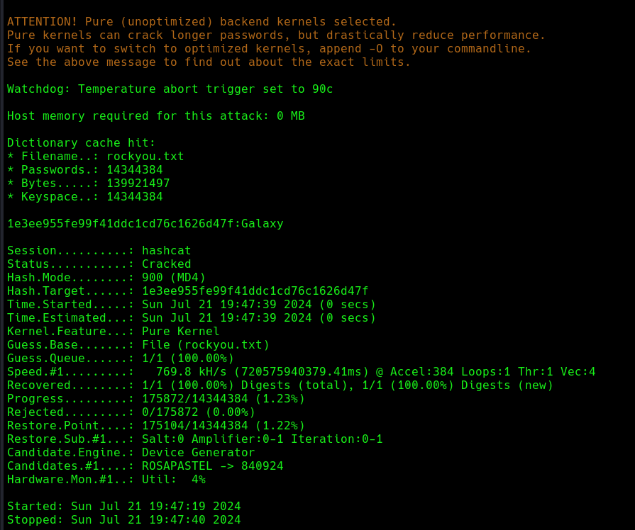
STEP 4
Password is as shown Galaxy.
Wordlist used = rockyou.txt
Hash-type = MD4

